Slide 1

Tools and Review
Installing Python
REPL
Python Review
Zoo
Notes:
Welcome to advanced python! You’ve had intro to python, but you might be a little rusty. Let’s start the course with a little review.
In this lesson we’ll look at the interactive python REPL … Read Execute Print Loop … this is what you get when you start python without the name of a script to run.
We’ll warm up to writing python with a cool little program: the Zoo

Slide 2

See Also
https://www.informatics.indiana.edu/rocha/academics/i-bic/lab1/Python%20review.pdf
https://www.python.org/about/gettingstarted/
https://www.jetbrains.com/pycharm/
Notes:
Here is some additional reading about the web … on the web

Slide 3
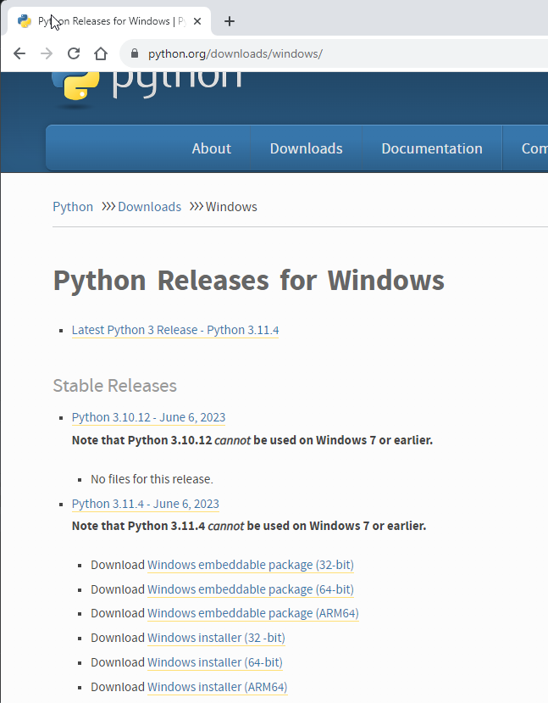
Installing Python
https://www.python.org/downloads/windows/
Notes:
Here’s how to install python on your computer if you don’t already have it installed.
I’m on a windows machine – I picked the “windows” installer. You can use whatever you like for this course: Windows, Mac, or Linux.
I’m using windows – #1 – my machine is a 64-bit architecture. Download the installer and run it. That’s all there is to it.
Reach out to me if you need help installing the tools. We will figure it out together!

Slide 4
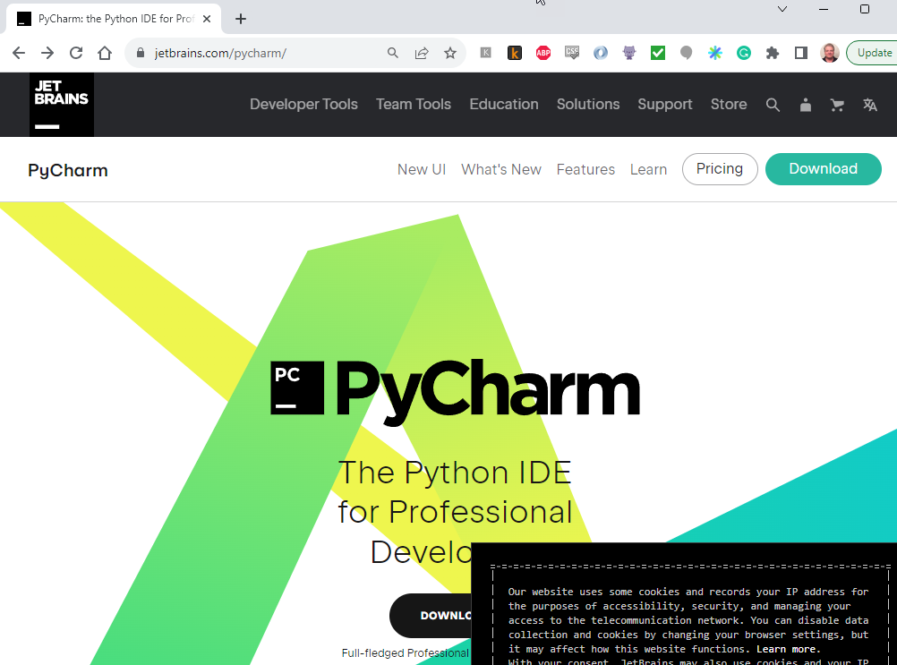
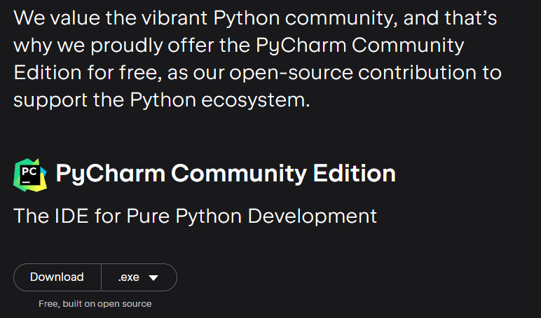
Installing PyCharm
https://www.jetbrains.com/pycharm/
Notes:
You likely have a favorite python IDE already. You can use whatever you like in this course.
I used Eclipse in the examples you’ll see in this course. At work, we use the free Microsoft VSCode for python.
If you don’t have a favorite or would like to try something new, I recommend PyCharm from jetbrains.
Go to their web page. #1 click download
#2 Then scroll down the page to the free “Community Edition”. #3 download the installer and follow the directions.
Again, reach out to me if you have problems or questions installing the tools.

Slide 5
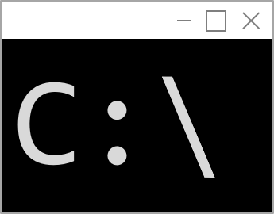
The Command Line
Command Prompt
C:\UAH>py
Python 3.6.4 (v3.6.4:d48eceb, Dec 19 2017, 06:54:40) [MSC v.1900 64 bit (AMD64)] on win32
Type "help", "copyright", "credits" or "license" for more information.
>>> 1+2
3
>>> print(5+5)
10
>>> for x in range(2,5):
... print(x)
...
2
3
4
>>> quit()
C:\UAH>

Slide 6
Review: Functions
Functions take arguments and return values
You can return multiple things
Variables declared in a function are transient locals
def getYesNo(prompt):
ret = input(prompt).capitalize()[0]
# This is a comment
return 1234, ret
i = getYesNo("First ")
print(i)
print(i[0])
i,j = getYesNo("Second ")
print(i)
print(j)

Slide 7
Review: Variables
a = 5.2
b = a + 2
c = False
d = None
g = [1,2,3,"Hello",4]
print(g[2])
print(g[3])
del g[2]
g.append("World")
print g
3
Hello
[1, 2, 'Hello', 4, 'World']

Slide 8
Everything is a Pointer
More in a later lecture
>>> a = [1,2,3]
>>> a.append(a)
>>> a[3][3][3][3][3][3][3][3][3][3][3][3][3][3][3][3][3][2]
3
>>>

Slide 9
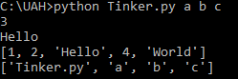
Command Line Arguments
import sys
print(sys.argv)
print(sys.argv[1])

Slide 10
Dictionaries
TODO

Slide 11
Example: The Zoo
animals = {
"Question" : "Does it live on land?",
"No" : "Fish",
"Yes" : {
"Question": "Does it fly?",
"Yes" : "Bird",
"No" : "Cow"
}
}
def getYesNo(prompt):
ret = input(prompt).capitalize()[0]
if ret=="Y":
return "Yes"
return "No"
node = animals
while True:
ans = getYesNo(node["Question"]+" ")
next_node = node[ans]
if type(next_node) is not str:
node = next_node
continue
got_it = getYesNo("Is it a "+next_node+"? ")
Streams of bytes … two ways (into your program and out of your program)
Disks, consoles, sockets, keyboards, printers
Know how to talk streams and you can talk to anything
Initialization (constructor) is different. Use is the same.

Slide 12
Example: The Zoo
if got_it == 'Yes':
print("Let's play again.")
node = animals
continue
print "You stumped me."
new_animal = input("What were you thinking of? ")
new_ques = input("Give me a question to separate "+next_node+" from "+new_animal+": ")
yn = getYesNo("And what would the Y/N answer be for "+new_animal+"? ")
new_node = {"Question":new_ques}
if yn=='Yes':
new_node['Yes'] = new_animal
new_node['No'] = next_node
else:
new_node['Yes'] = next_node
new_node['No'] = new_animal
node[ans] = new_node
print("Let's play again.")
node = animals
Streams of bytes … two ways (into your program and out of your program)
Disks, consoles, sockets, keyboards, printers
Know how to talk streams and you can talk to anything
Initialization (constructor) is different. Use is the same.

Slide 13
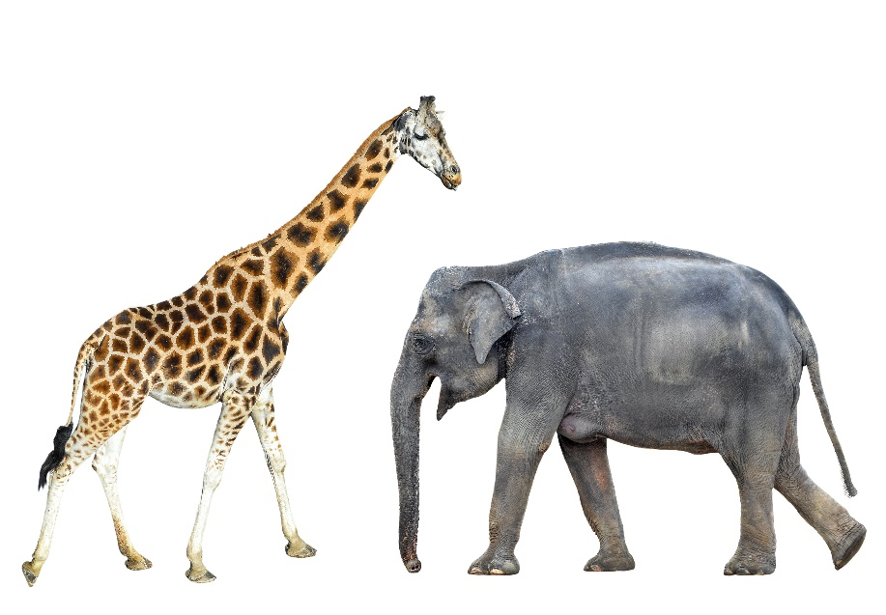
Tinkering
Create an empty python project in your IDE
Type in the Zoo example
How could you load the zoo at the beginning of the game and save it when a new animal is added?
Notes:
Here are some tinkering exercises for you before the next lesson.
These are totally optional. There is nothing for you to send to me. Just some optional things you might want to try.
Try creating an empty project in your IDE of choice. Then type in the zoo example that we just did. Follow along with the video as I typed it.
And how can you save the data along the way and reload it when the game starts? That’s a good challenge – python’s JSON library makes it easy.
Send me questions or comments through email. I’ll see you next time.

Slide 14
Python 2.x or 3.x
https://www.dataquest.io/blog/python-2-or-3/
Python 3.x started in 2008 (a DECADE ago)
The versions are incompatible
Nearly all popular libraries support Python 3 now
Python 2.x is scheduled end-of-life in 2020
Django version 2.0 does not support Python version 2.x
Learn Python 3.x

Slide 15
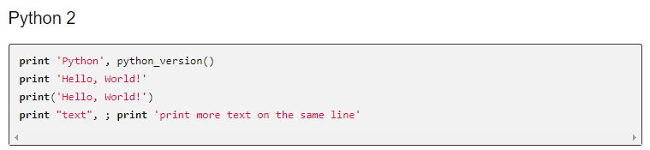
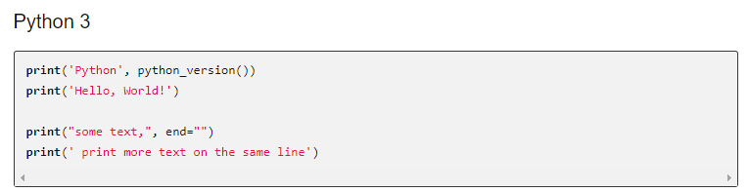
Python 2.x vs 3.x
http://sebastianraschka.com/Articles/2014_python_2_3_key_diff.html

Slide 16
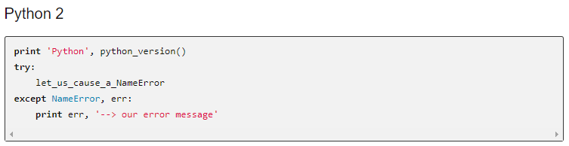
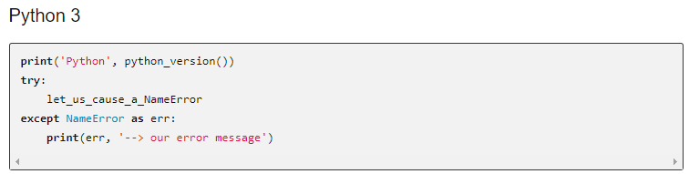
Python 2.x vs 3.x

Slide 17
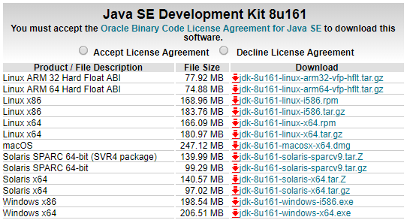
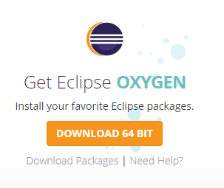
Pydev and Eclipse
http://www.oracle.com/technetwork/java/javase/downloads/jdk8-downloads-2133151.html
https://www.eclipse.org/downloads/

Slide 18
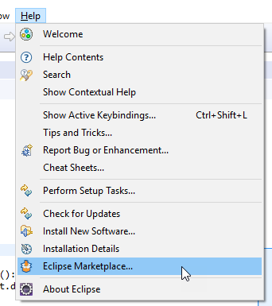
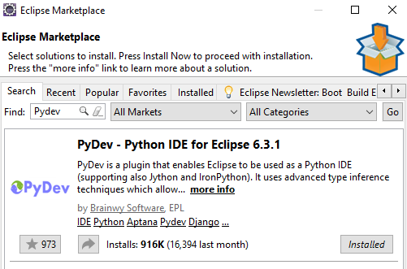
Pydev and Eclipse

Slide 19
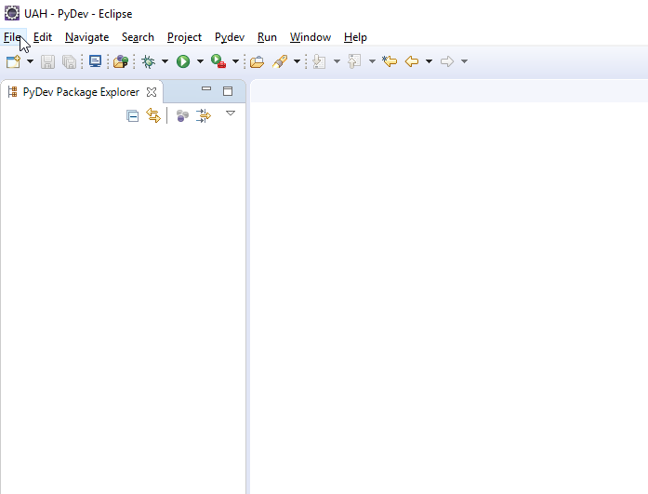
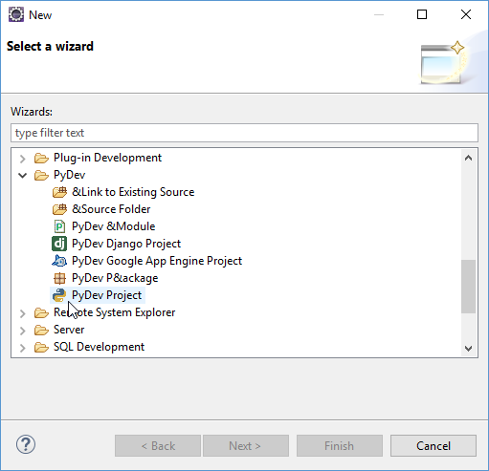
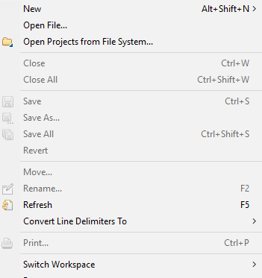
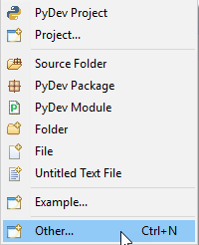
New Project

Slide 20
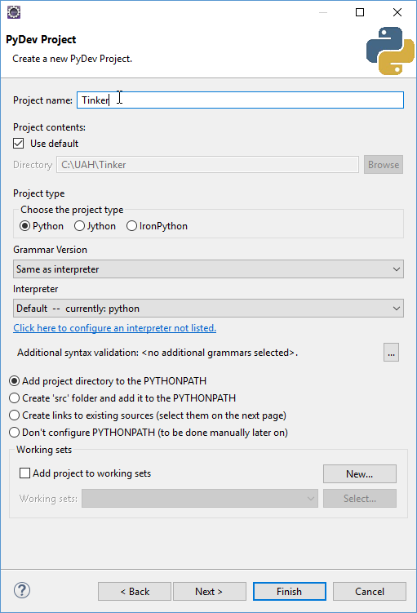
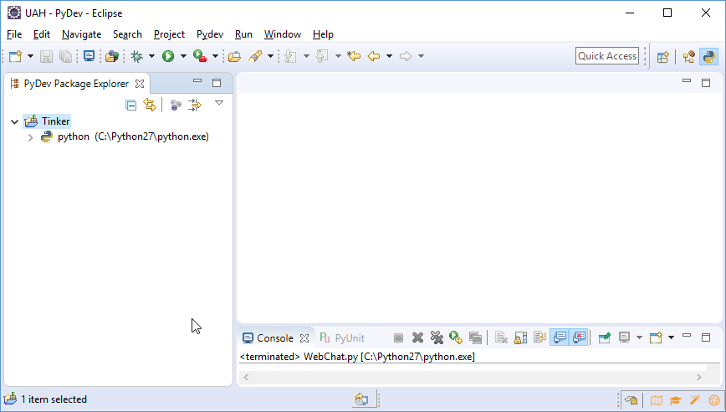
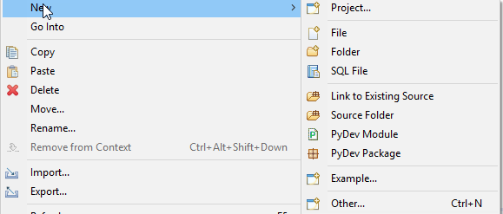
New Project

Slide 21
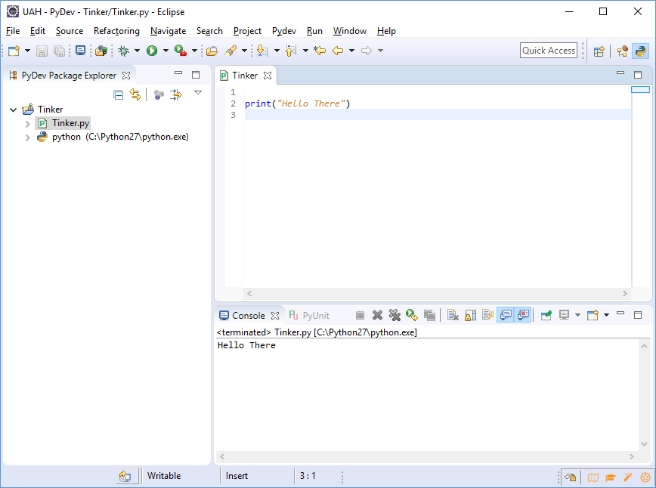
New Project

